Slide 1
DS105 : DATA INTEGRATION

Slide 2
Outline
This week
Data Integration

Slide 3
Reading Assignment
Papers
Data Fusion: Resolving Conflicts from Multiple Sources by Luna Dong et. al. [PDF]
Data Preprocessing / Cleaning
Chapter 2 from Data Mining : Concepts and Techniques [PDF]

Slide 4




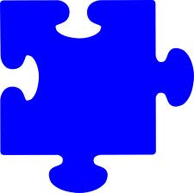
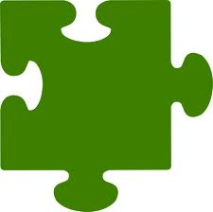
What is “Data Integration”?
Data integration is much like a jigsaw puzzle
There are many sources that have relevant pieces, but no one source provides a complete picture.
A data integration system gathers relevant pieces from various sources to provide a comprehensive view of the data.
S2
S3
S1
Data Integration System

Slide 5
What is “Data Integration”? (Cont.)
Combining information from multiple autonomous and heterogeneous sources with the goal of proving a uniform, complete and consistent interface of answering queries over the integrated sources.
Uniform access
Same query posed once to all sources
Multiple, autonomous and heterogeneous sources
Multiple – usually hundreds to thousands of sources
Heterogeneous – data source ‘schema’ are different
Schema refers to how a data source represents its data internally
Autonomous – data sources don’t report to the data integration system when data or schema changes
Complete
Containing all relevant answers (records) from the various sources
For a given record, having all relevant attributes
Consistent
Duplicate records are removed
Invalid or conflicting data is resolved

Slide 6
Why is “Data Integration” a hard problem?
When considering data integration, its all about the Vs
Size:
Large volume of data
Each data source may be large, but there are many sources for a single domain.
Collected and analyzed at high velocity
Data is generated at a high rate.
Complexity:
Huge variety of data
Sources (even in the same domain, have heterogeneous schemas.
Questionable veracity
Some sources may provide inaccurate data (or data that is not fresh).

Slide 7
Applications of Data Integration
Many Applications
WWW
Comparison shopping ( GoogleFlights, Kayak, etc. )
News, or business aggregators
Business-to-business, electronic marketplaces
Science informatics
Integrating genomic data, geographic data, archaeological data, astro-physical data, etc.
Enterprise data integration
An average company has 49 different databases and spends 35-50% of its IT dollars on integration efforts
Knowledge Databases
YAGO – a knowledge database that integrates wikipedia and other sources
DBpedia
Notes:
‹#›
Today I will be presenting a recent research paper in the area of data integration.
The problem of information integration is an old one, but still relevant.
There are many applications that must address this problem.
In the WWW, there are many sources that must be integrated to build applications such as comparison shopping, publication listing, restaurant listings, etc. Examples are aggregators such as kayak or news aggregators such as google news.
Information integration is also relevant for scientific data, where different institutions, such as universities, research labs, etc. want to share data.
And its also relevant to the traditional problem of enterprise data integration, where business must combine databases that might contain product listing, customer information, etc. Walmart, etc.

Slide 8















Application Area : The Web
Business Listings
News Aggregators
Travel (Flight/Hotel) Aggregators
Legal article/patents Aggregators

Slide 9




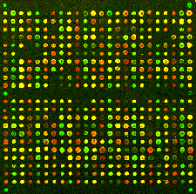

Application Area : Science
Phenotype
Gene
Sequenceable Entity
Structured Vocabulary
Nucleotide Sequence
Microarray Experiment
Protein
OMIM
HUGO
Swiss-
Prot
GO
Gene-
Clinics
Locus-
Link
Entrez
GEO
Hundreds of biomedical data sources available
Notes:
HUGO gene nomenclature
Gene Expression Omnibus (GEO)
protein sequence database (swissprot)
GO
Entrez
Locouslink

Slide 10

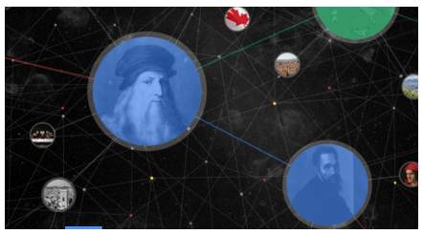
Application Area: Knowledge Bases
Building Web-Scale Knowledge bases
Google Knowledge Graph

Slide 11
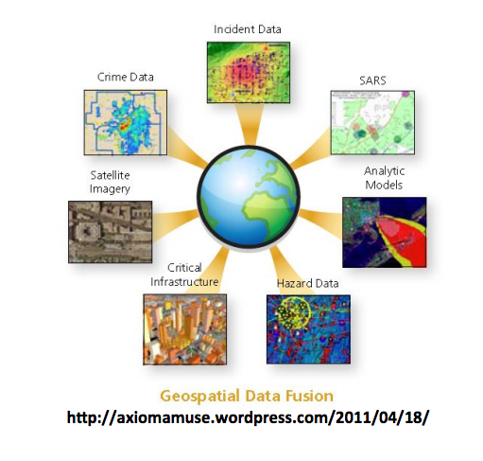
Application Area: GIS
Geo-spatial data fusion

Slide 12
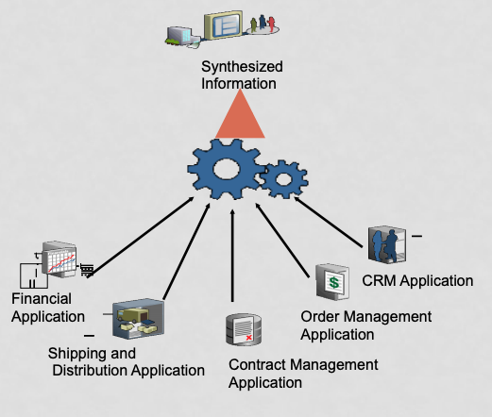
Data Integration is standard
Data integration is also valid within a single organization.
Integrating data from different departments or sectors
Usually referred to as ETA (Extract – Transform – Load)
Notes:
L

Slide 13
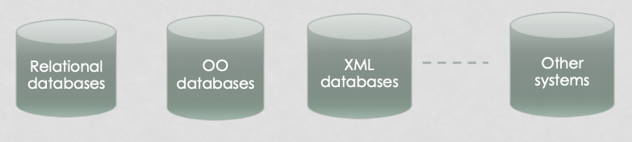
HETEROGENEITY PROBLEMS
The main problem is the heterogeneity among the data sources
Source Type Heterogeneity
Systems storing the data can be different

Slide 14
Approaches to Data Integration
Data Warehouses
Usually utilized for static or slowly changing data
Virtual Data Integration
Also called ‘Mediated Schema Integration’
Usually used for web data sources which publish new content at a high rate

Slide 15

Traditional Data Integration Solution
Data Warehouse
The warehouse system extracts, transforms and loads data from heterogeneous sources into a single data source so data becomes easily queryable.
Problems
Data has to be cleaned due to different formats
Requires a central storage system for all data
Data needs to be updated periodically to maintain ‘fresh’ data.
Data sources are autonomous, hence, content can change without notice.
Expensive because of the large quantities of data and data cleaning costs.
Query
Results
Data Warehouse
Global
Schema
Schema
Schema
Schema
S1
S2
S3
Data Sources
Notes:
The traditional solution has been data warehouses, where the data is extracted from data sources, transformed, and joined into 1 large source.
Since this step is expensive, it can not be done periodically, thus, the data is usually not up-to-date. In this era, especially on WWW, data changes at a fast rate, thus this solution is not feasible.

Slide 16
Data Integration using Mediated Schema
Mediated Schema Approach
Mediator is a virtual view over the data (it does not store any data)
Data is stored only at the sources
Mediator has a virtual schema that combines all schemas from the sources
The mapping takes place at query time
This is unlike warehousing where mapping takes place at upload time
Query
Results
Mediator
Wrapper
Wrapper
Wrapper
schema
schema
schema
S1
S2
S3
Notes:
The alternative solution currently used is Mediated Schema. Unlike Data Warehouse, data is maintained in the sources. Given a query, the relevant sources are identified, queried, and the results are combined. This is all done in a on-line fashion, thus the data is up-to-date.

Slide 17
Data Integration using Mediated Schema
Query is mapped to multiple other queries
Each query (or set of queries) are sent to the sources
Sources evaluate the queries and return the results
Results are merged (combined) together and passed to the end-user
Query
Results
Mediator
Wrapper
Wrapper
Wrapper
schema
schema
schema
S1
S2
S3

Slide 18
Problems in Data Integration
Data integration (whether building a data warehouse or mediated schema) usually involves the following phases.
Source Selection
Schema Mapping
Records Linkage
Data Fusion
Notes:
Query optimiaztion is more critical for mediated schema

Slide 19
Source Selection Phase
Query
Results
Source Selection (Query Optimizer)
Determine which sources are most relevant to the given query.
Determine the order of how sources should be accessed.
For this purpose, the query optimizer needs to access statistics about the coverage of the sources, as well as the overlap between sources.
Data Fusion
Query
Optimizer
4
1
Record-Linkage
3
answer
tuples
query
Global Schema
2
Schema
Mapping
Wrapper
Wrapper
Wrapper
schema
schema
schema
S1
S2
S3
Notes:
One component of such a system, is the query optimizer that must determine the set of relevant sources, and in which order they should be accessed.
For this, we would need to have some knowledge about the information (coverage) and overlap of information between sources.

Slide 20










Query Optimization
Restaurants in Boston ?
Select relevant sources for the given query.
Select order in which to query sources.
Consider quality of data provided sources (knowledge acquired from previous queries)
Coverage (# of answers)
Completeness (# of attributes)
Accuracy
Freshness

Slide 21
Schema Mapping Phase
Query
Results
Schema Mapping
Since each source is independent and autonomous, it has its own schema.
Objective: Generate a global virtual schema, and create a mapping between the global schema and the individual source schemas.
Data Fusion
Query
Optimizer
4
1
Record-Linkage
3
answer
tuples
query
Global Schema
2
Schema
Mapping
Wrapper
Wrapper
Wrapper
schema
schema
schema
S1
S2
S3
Notes:
A second component is schema mapping. Since each source is independent, it will have its own schema.
The mediator must genrate a mapping in order to query each of the sources.

Slide 22
Heterogeneity Problems
Schema Heterogeneity
The structure of the tables storing the data can be different (even if storing the same data)
Data Type Heterogeneity
Storing the same data (and values) but with different data types
E.g., Storing the phone number as String or as Number
E.g., Storing the name as fixed length or variable length
Value Heterogeneity
Same logical values stored in different ways
E.g., ‘Prof’, ‘Prof.’, ‘Professor’
E.g., ‘Right’, ‘R’, ‘1’ ……… ‘Left’, ‘L’, ‘-1’

Slide 23

Heterogeneity Problems (Cont.)
Semantic Heterogeneity
Same values in different sources can mean different things
E.g., Column ‘Title’ in one database means ‘Job Title’ while in another database it means ‘Person Title’
Data integration has to deal with all such issues and more

Slide 24
Schema Matching Example
Need to resolve differences in schema and data representation.
S1
Business Name | Phone | Specialty | Address | Website
Thai Boat | (805) 594-1638 | Asian | 3212 Broad St San Luis Obispo, CA | thaiboatslo.com
Jaffa Cafe | (805) 543-2400 | Mediterranean | 1308 Monterey St San Luis Obispo, CA | jaffacafe.us
Taste | (805) 541-5860 | American, Burgers | 2900 Broad St San Luis Obispo, CA | taste2900.com
S2
Listing Name | Phone | Cuisine | Street Address | City | State
Thai Boat | 805-594-1638 | Thai | 3212 Broad St #100 | San Luis Obispo | CA
Jaffa Cafe | 805-543-2449 | Lebanese | 1308 Monterey St | San Luis Obispo | CA
Taste | 805-541-5860 | American | 2900 Broad St | San Luis Obispo | CA
Oasis | 805-543-1155 | Greek | 675 Higuera St | San Luis Obispo | CA

Slide 25
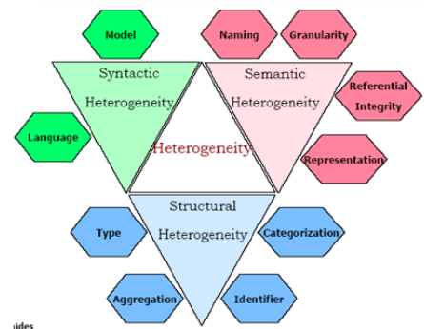
Challenges in Schema Matching

Slide 26
Schema Mapping Approaches (Cont.)
Current Approaches
Manual or Semi-Supervised Schema Matching
Schema Matching Approaches
Linguistic approach
Find semantically similar schema elements
Ex. S1.make = S2.brand
How is similarity defined?
Equality of names
Equality of names after stemming, deals with prefixes/suffixes
Equality of synonyms
Similarity of names based on common substring (edit-distance)
User provided name matches

Slide 27
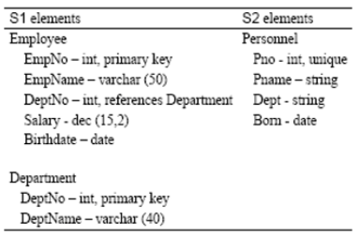
Schema Mapping Approaches (Cont.)
Schema Matching Approaches
Constraint-based approach
Utilize contains to determine similar schema elements
Data types
Uniqueness-constraints
Value-range constraints
Relationship-types
* A Survey of Approaches to Automatic Schema Matching by E. Rahm , P. Bernstein

Slide 28
Record Linkage Phase
Query
Results
Record Linkage (duplicate detection or entity resolution)
Input: List of records from sources.
Output: For each real-world object, it assigns a object-ID to the record.
Objective: Finds records from different sources that may represent the same real-world object.
Data Fusion
Query
Optimizer
4
1
Record-Linkage
3
answer
tuples
query
Global Schema
2
Schema
Mapping
Wrapper
Wrapper
Wrapper
schema
schema
schema
S1
S2
S3

Slide 29
Record Linkage Example
Link records that correspond to the same ‘object’
S1
Business Name | Phone | Specialty | Address | Website
Thai Boat | (805) 594-1638 | Asian | 3212 Broad St San Luis Obispo, CA | thaiboatslo.com
Jaffa | (805) 543-2400 | Mediterranean | 1308 Monterey St San Luis Obispo, CA | jaffacafe.us
Taste | (805) 541-5860 | American Cafe | 2900 Broad St San Luis Obispo, CA | taste2900.com
S2
Listing Name | Phone | Cuisine | Street Address | City | State
Thai Boat | 805-594-1638 | Thai | 3212 Broad St #100 | San Luis Obispo | CA
Jaffa Cafe | 805-543-2449 | Lebanese | 1308 Monterey St | San Luis Obispo | CA
Taste | 805-541-5860 | American | 2900 Broad St | San Luis Obispo | CA
Oasis | 805-543-1155 | Greek | 675 Higuera St | San Luis Obispo | CA

Slide 30
Reasons for mismatching
Misspelling
“Smith”, “Smeth”, “Snith”
Variant names, synonyms, and abbreviations
“St.”, “St”, “Street”…..“Prof”, “Professor”….”car”, “vehicle”
Different systems
“Chin Le”, “Le, Chin”… “10/02/2000”, “10-02-2000”, “02-10-2000”
Different domains
“YES/NO”, “1/0”, “T/F”

Slide 31
MECHANISMS FOR ENTITY RESOLUTION
Edit Distance
Compare string fields using edit distance function
Can assign different weights to different fields
Normalization & Ontology
Using a dictionary, replace all abbreviations with a standard forms
Ontology helps in synonyms
Clustering and Partitioning
Run a clustering-based algorithm over the returned records
Tuples belonging to the same cluster can be further tested for matching

Slide 32
Data Fusion Phase
Query
Results
Data Fusion
Input: Receives list of records (with object-ID) from record-linkage phase.
Output: Concise, complete, and consistent record list (answer list).
Objective: Fuse records from different sources that relate to the same real-world object and resolve inconsistencies and conflicts.
Also known as: data merging, consolidation, entity resolution, finding representatives/survivors, instance-level conflict resolution
Data Fusion
Query
Optimizer
4
1
Record-Linkage
3
answer
tuples
query
Global Schema
2
Schema
Mapping
Wrapper
Wrapper
Wrapper
schema
schema
schema
S1
S2
S3

Slide 33
Data Fusion Example
Fuse data and resolve conflicts and inconsistencies
Basic approach uses voting, or can utilize weighted vote (like PageRank)
For this record, S1 stated the phone # was (805)-543-2400 while S2 stated it was 805-543-2449.
Which source to trust?
Fused Data
Name | Phone | Cuisine | Address | Website
Thai Boat | 805-594-1638 | Thai | 3212 Broad St #100 San Luis Obispo CA | thaiboatslo.com
Jaffa Cafe | 805-543-2449 | Mediterranean | 1308 Monterey St San Luis Obispo CA | jaffacafe.us
Taste | 805-541-5860 | American | 2900 Broad St San Luis Obispo CA | taste2900.com
Oasis | 805-543-1155 | Greek | 675 Higuera St San Luis Obispo CA

Slide 34
Data Fusion
Naïve solution is to simply use the information that is asserted by the largest number of data sources (i.e., naive voting).
Its inadequate since biased (and even malicious) sources abound, and plagiarism (i.e., copying without proper attribution) between sources may be widespread.
Ideally, when applying voting, we would like to give a higher vote to more trustworthy sources and ignore copied information.
First, we often do not know a priori the trustworthiness of a source.
Second, in many applications we do not know how each source obtains its data, so we have to discover copiers from a snapshot of data.
Paper “Data Fusion: Resolving Conflicts from Multiple Sources” by Dong et. Al. examines the problem of data fusion in more detail. [PDF]

Slide 35
Strategies for Dealing with Missing Data
After performing data fusion, we must also deal with other inconsistences in the data, such as:
Missing values
Null values

Slide 36
Missing Values
There are several strategies for dealing with missing data.
Reducing dataset
The simplest solution for the missing values imputation problem is the reduction of the data set and elimination of all samples with missing values.
Replace Missing Value with Mean
This method replaces each missing value with mean of the attribute (Kantardzic, M. 2003). The mean is calculated based on all known values of the attribute. This method is usable only for numeric attributes and is usually combined with replacing missing values with most common attribute value for symbolic attributes.
Replace Missing Value with Median for the Given Class
Since the mean is affected by the presence of outliers it seems natural to use the median instead just to assure robustness. In this case the missing data for a given attribute is replaced by the median of all known values of that attribute in the class where the instance with the missing value belongs (Acuña, E. & Rodriguez, C. 2004). This method is usable only for numeric attributes and requires existence of classes or possibility to create classes as previous method
Notes:
Use the attribute mean or median for all samples belonging to the same class as the given tuple. For example, if classifying customers according to “credit-risk”, we may replace the missing value with the mean income value for customers in the same credit risk category as that of the given tuple. If the data distribution for a given class is skewed, the median value is a better choice.

Slide 37
Missing Values (Cont.)
Replace Missing Value with Most Common Attribute Value
This method simply uses most common attribute value for missing value imputation (Grzymala-Busse J. W., Hu M. 2001). The most common value of all values of the attribute is used. This method is usable only for symbolic attributes and is usually combined with replacing missing values with missing values imputation using mean for numeric attributes.
Closest Fit
The closest fit algorithm (Grzymala-Busse, J. W., Goodwin, L. K., Grzymala-Busse, W. J. & Zheng X. 2005) for missing attribute values is based on replacing a missing attribute value with an existing value of the same attribute from another case that resembles as much as possible the case with missing attribute values.
This approach can be generalized to using K nearest neighbor, which will look for more than one (“k”) similar cases with known values of the attribute (Hand, D., Mannila, H. & Smyth, P. 2001).

Slide 38
Data Fusion literature
Data Fusion: Resolving Conflicts from Multiple Sources by Luna Dong et. al. [PDF]
Examined the data fusion problem over numerous data sources where sources accuracy is considered.
Usually, conflicts in data fusion is solved through voting.
Sources may copy from others, and since these sources are dependent on other sources, their vote should not hold as much weight.
The paper addressed the following questions:
How can we discover source dependence ?
How should we fuse data given source dependence ?

Slide 39
Problem Definition—Input
Objects: a real-world entity, described by a set of attributes
Each associated w. a true value
Sources: each providing data for a subset of objects
Src | ISBN | Name | Author
S1 | 1 | IPV6: Theory, Protocol, and Practice | Loshin, Peter
 | 2 | Web Usability: A User-Centered Design Approach | Lazar, Jonathan
S2 | 1 | IPV4: Theory, Protocol, and Practice | -
 | 2 | Web Usability: A User | Jonathan Lazar
S3 | 1 | IPV6: Theory, Protocol, and Practice | Loshin, Peter
 | 2 | Web Usability: A User | Jonathan Lazar
S4 | 1 | IPV6: Theory, Protocol, and Practice | Loshin
 | 2 | Web Usability: A User | Lazar
Missing values
Incorrect values
Different formats

Slide 40
Problem Definition—Output
For each S1, S2, decide pr of S1 copying directly from S2
A copier copies all or a subset of data
A copier can add values and verify/modify copied values—independent contribution
A copier can re-format copied values—still considered as copied
Src | ISBN | Name | Author
S1 | 1 | IPV6: Theory, Protocol, and Practice | Loshin, Peter
 | 2 | Web Usability: A User-Centered Design Approach | Lazar, Jonathan
S2 | 1 | IPV4: Theory, Protocol, and Practice | -
 | 2 | Web Usability: A User | Jonathan Lazar
S3 | 1 | IPV6: Theory, Protocol, and Practice | Loshin, Peter
 | 2 | Web Usability: A User | Jonathan Lazar
S4 | 1 | IPV6: Theory, Protocol, and Practice | Loshin
 | 2 | Web Usability: A User | Lazar
S1
S2
S3
S4

Slide 41
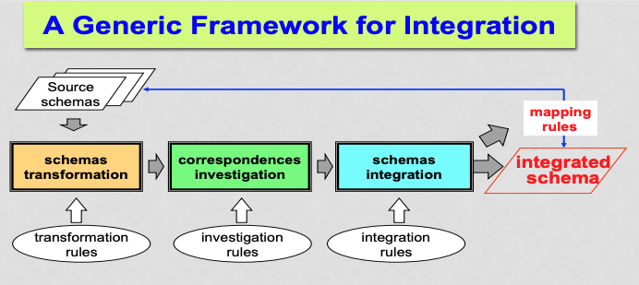
Summary
Data Integration is important , the question is can we automate this process??
Ongoing research
How to match their schemas automatically " schema matching techniques
How to find matching records " record linkage techniques
How to find errors, synonyms, etc. and correct them " data cleansing techniques

